Slide 1

5.5
Integration by Substitution
Copyright © Cengage Learning. All rights reserved.

Slide 2
Objectives
Use pattern recognition to find an indefinite integral.
Use a change of variables to find an indefinite integral.
Use the General Power Rule for Integration to find an indefinite integral.

Slide 3
Objectives
Use a change of variables to evaluate a definite integral.
Evaluate a definite integral involving an even or odd function.

Slide 4
Pattern Recognition

Slide 5
Pattern Recognition
In this section you will study techniques for integrating composite functions.
The discussion is split into two parts—pattern recognition and change of variables. Both techniques involve a u-substitution.
With pattern recognition you perform the substitution mentally, and with change of variables you write the substitution steps.
The role of substitution in integration is comparable to the role of the Chain Rule in differentiation.

Slide 6
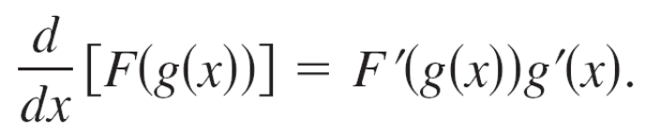
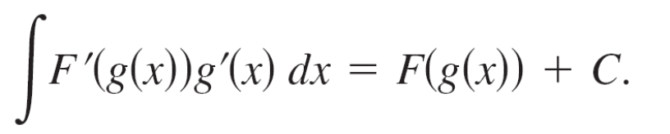
Pattern Recognition
Recall that for differentiable functions given by y = F(u) and
u = g(x), the Chain Rule states that
From the definition of an antiderivative, it follows that

Slide 7
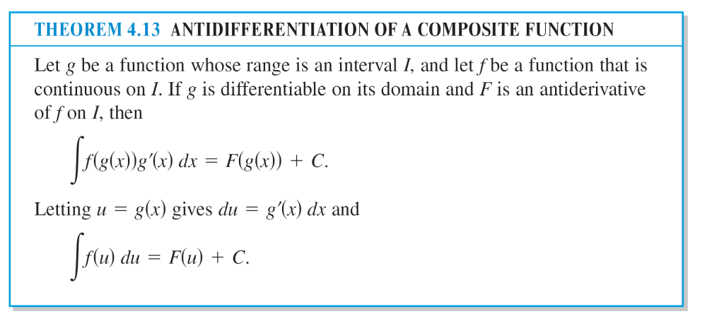
Pattern Recognition
These results are summarized in the following theorem.

Slide 8
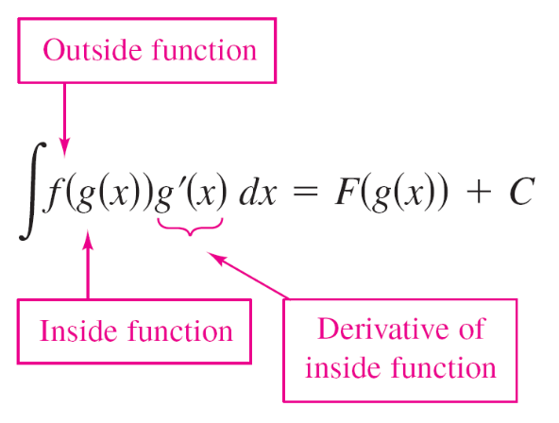
Pattern Recognition
Example 1 show how to apply Theorem 4.13 directly, by recognizing the presence of f(g(x)) and g'(x).
Note that the composite function in the integrand has an outside function f and an inside function g.
Moreover, the derivative g'(x) is present as a factor of the integrand.

Slide 9
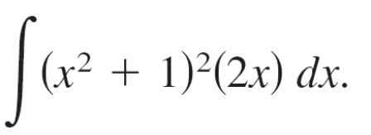
Example 1 – Recognizing the f(g(x))g'(x) Pattern
Find
Solution:
Letting g(x) = x² + 1, you obtain
g'(x) = 2x
and
f(g(x)) = f(x² + 1) = (x² + 1)².
From this, you can recognize that the integrand follows the f(g(x))g'(x) pattern.

Slide 10
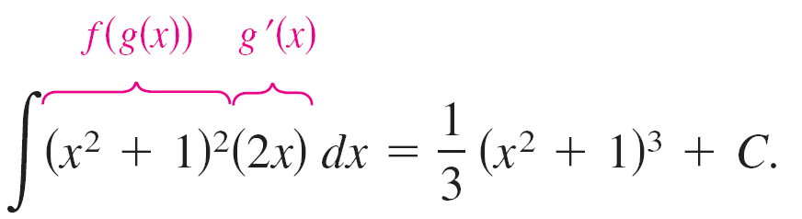
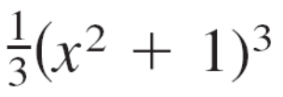
Example 1 – Solution
cont’d
Using the Power Rule for Integration and Theorem 4.13, you can write
Try using the Chain Rule to check that the derivative of
+ C is the integrand of the original integral.

Slide 11
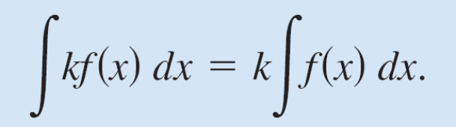
Pattern Recognition
The integrands in Example 1 fit the f(g(x))g'(x) pattern exactly—you only had to recognize the pattern.
You can extend this technique considerably with the Constant Multiple Rule
Many integrands contain the essential part (the variable part) of g'(x) but are missing a constant multiple.
In such cases, you can multiply and divide by the necessary constant multiple, as shown in Example 3.

Slide 12
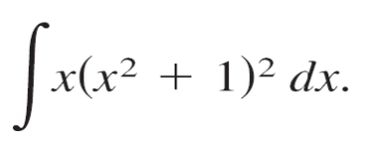
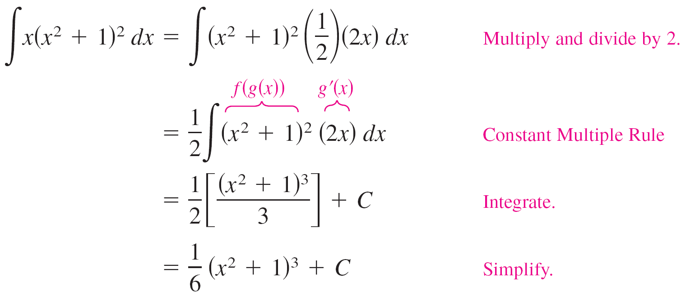
Example 3 – Multiplying and Dividing by a Constant
Find
Solution:
This is similar to the integral given in Example 1, except that the integrand is missing a factor of 2.
Recognizing that 2x is the derivative of x² + 1, you can let g(x) = x² + 1 and supply the 2x as follows.

Slide 13
Change of Variables

Slide 14
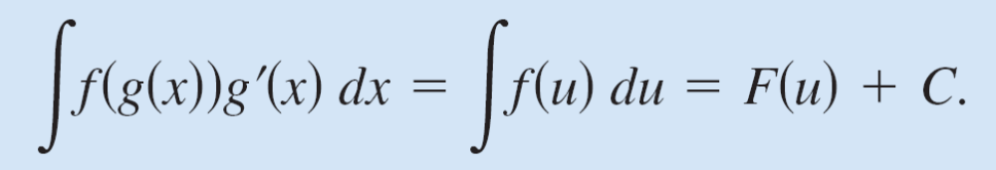
Change of Variables
With a formal change of variables, you completely rewrite the integral in terms of u and du (or any other convenient variable).
Although this procedure can involve more written steps than the pattern recognition illustrated in Examples 1 and 3, it is useful for complicated integrands.
The change of variables technique uses the Leibniz notation for the differential. That is, if u = g(x), then du = g'(x)dx, and the integral in Theorem 4.13 takes the form

Slide 15
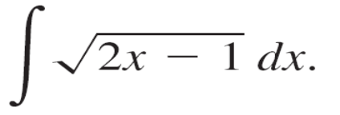


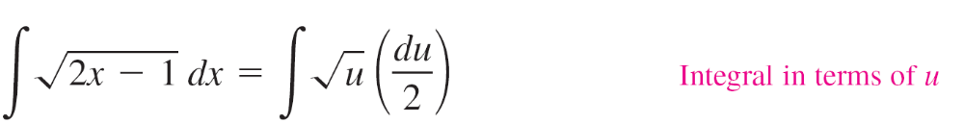
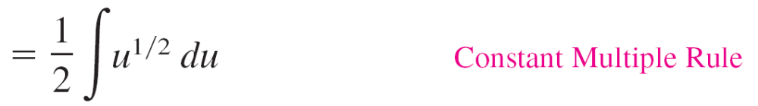
Example 4 – Change of Variables
Find
Solution:
First, let u be the inner function, u = 2x – 1.
Then calculate the differential du to be du = 2dx.
Now, using and substitute to obtain

Slide 16
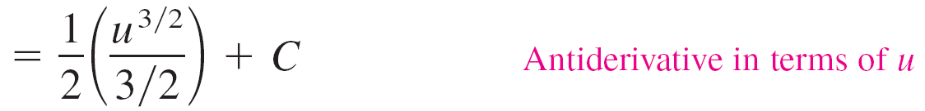
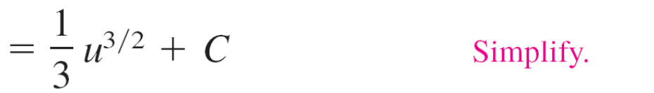
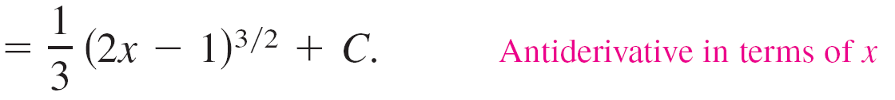
Example 4 – Solution
cont’d

Slide 17
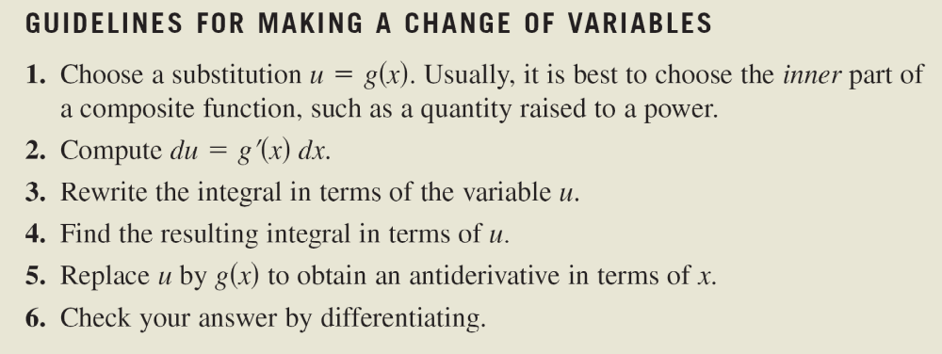
Change of Variables
The steps used for integration by substitution are summarized in the following guidelines.

Slide 18
The General Power Rule for Integration

Slide 19
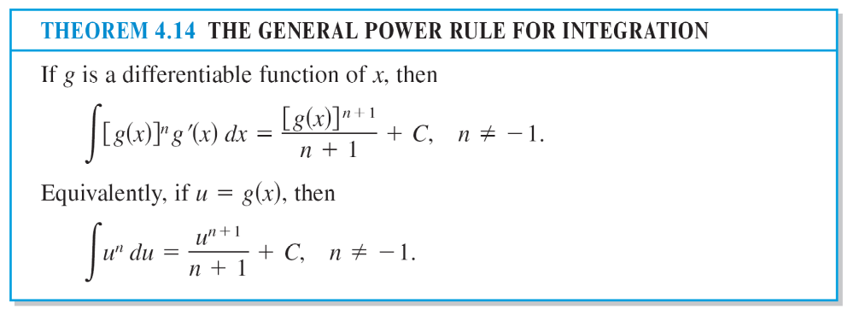
The General Power Rule for Integration
One of the most common u-substitutions involves quantities in the integrand that are raised to a power.
Because of the importance of this type of substitution, it is given a special name—the General Power Rule for Integration.

Slide 20
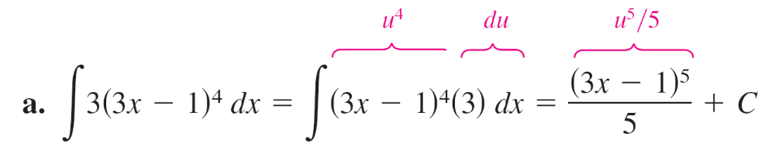
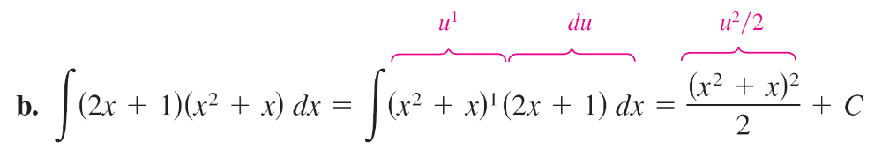
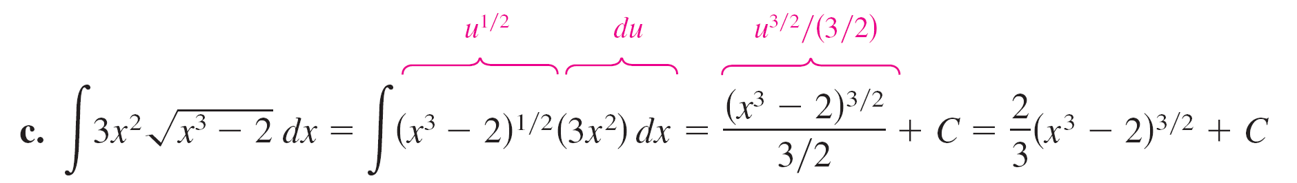
Example 7 – Substitution and the General Power Rule

Slide 21
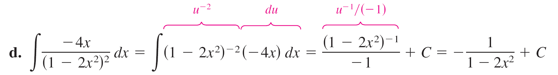
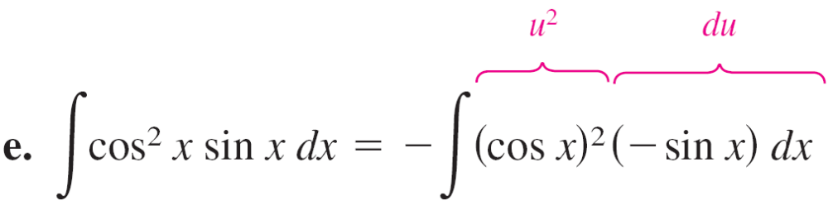
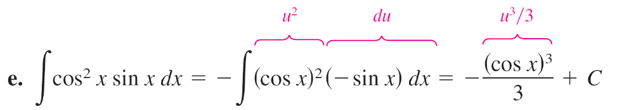
Example 7 – Substitution and the General Power Rule
cont’d

Slide 22
Change of Variables for Definite Integrals

Slide 23
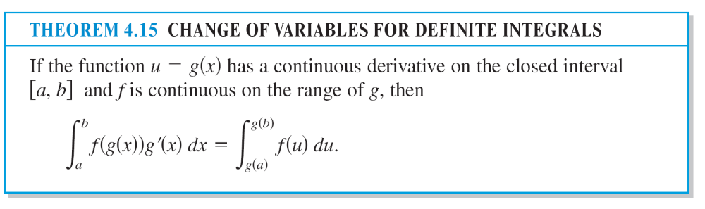
Change of Variables for Definite Integrals
When using u-substitution with a definite integral, it is often convenient to determine the limits of integration for the variable u rather than to convert the antiderivative back to the variable x and evaluate at the original limits.
This change of variables is stated explicitly in the next theorem.

Slide 24
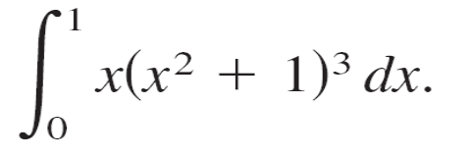

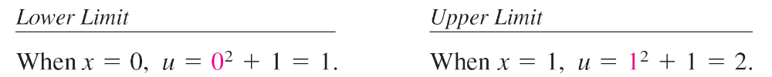
Example 8 – Change of Variables
Evaluate
Solution:
To evaluate this integral, let u = x² + 1.
Then, you obtain
Before substituting, determine the new upper and lower limits of integration.

Slide 25
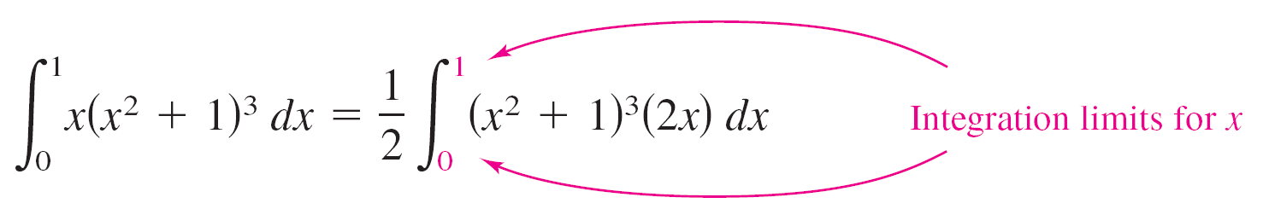
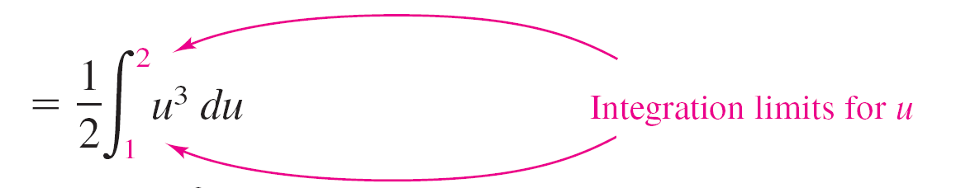
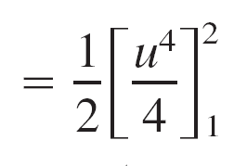
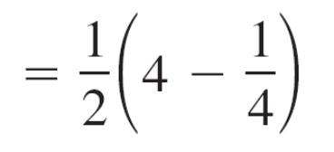
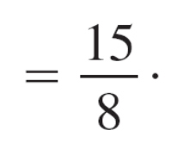
Example 8 – Solution
cont’d
Now, you can substitute to obtain

Slide 26
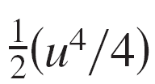
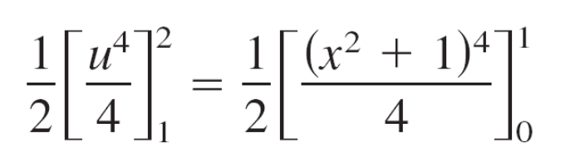
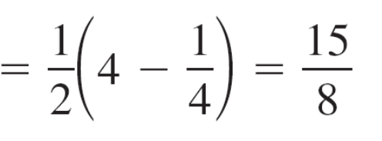
Example 8 – Solution
cont’d
Try rewriting the antiderivative in terms of the variable x and evaluate the definite integral at the original limits of integration, as shown.
Notice that you obtain the same result.

Slide 27
Integration of Even and Odd Functions

Slide 28
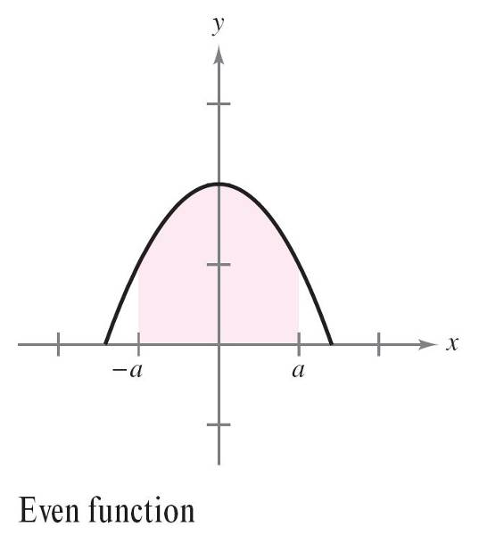
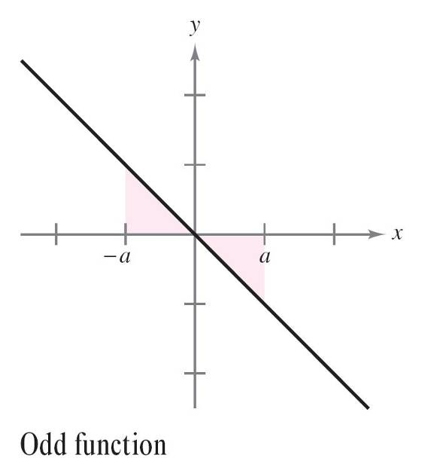
Integration of Even and Odd Functions
Even with a change of variables, integration can be difficult.
Occasionally, you can simplify the evaluation of a definite integral over an interval that is symmetric about the y-axis or about the origin by recognizing the integrand to be an even or odd function (see Figure 4.40).
Figure 4.40

Slide 29
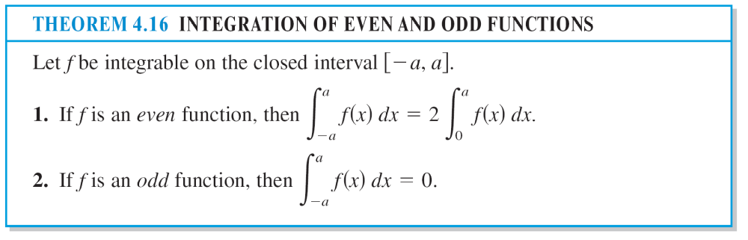
Integration of Even and Odd Functions

Slide 30
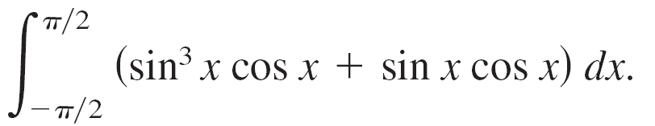
Example 10 – Integration of an Odd Function
Evaluate
Solution:
Letting f(x) = sin³x cos x + sin x cos x produces
f(–x) = sin³(–x) cos (–x) + sin (–x) cos (–x)
= –sin³x cos x – sin x cos x = –f(x).

Slide 31
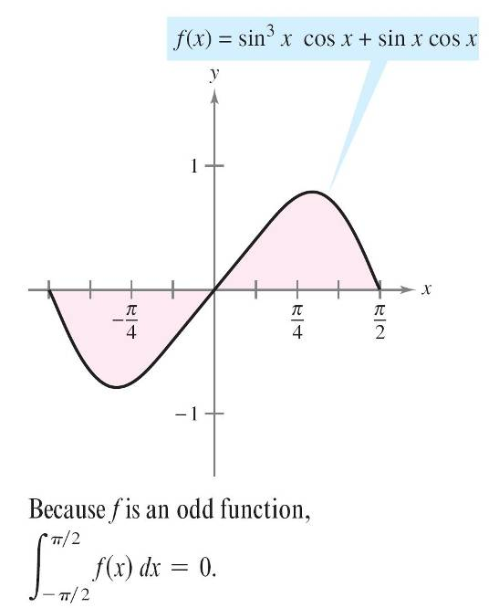
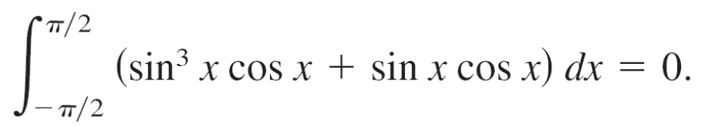
Example 10 – Solution
cont’d
So, f is an odd function, and because f is symmetric about the origin over [–π/2, π/2], you can apply Theorem 4.16 to conclude that
Figure 4.41

